Slide 1
Internet Tools and the furniture Business
Anne Kulwattanasopon
Nick Beckworth
Tom Wootten
Steven Blair
Annie Billings

Slide 2
Introduction
IKEA
Ashley Furniture
Pottery Barn
Crate&Barrel

Slide 3
IKEA
Background
began in 1926 by Ingvar Kamprad
Products
product range is wide in
function/style/coordination
IKEA.com
started in 1997

Slide 4
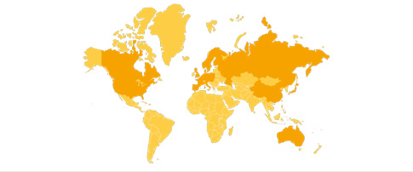
IKEA
Business Idea
To offer a wide range of well designed, functional
home furnishing products at prices so low that
as many people as possible will be able to afford them.
Target Market

Slide 5
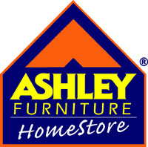
Ashley Furniture
Background
By Carlyle Weinberger in Chicago in 1945
Vision
We Want To Be The Best Furniture Company
Internet
started in 1996

Slide 6
Pottery Barn
Background
Began in 1949 in Manhattan
Business Idea
Home furnishings should be exceptional in comfort, style and quality
Internet
started in 1995

Slide 7
Crate&Barrel
Background
Started in 1962 by Gordon and Carole Segal
Business Idea
Crate&Barrel offer the wonderfully simple designs at wonderfully simple, affordable prices.
Internet
Started in 1999

Slide 8
Company Websites

Slide 9
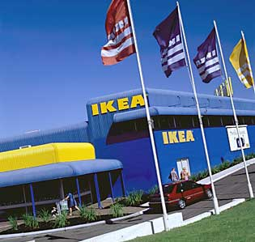
IKEA.com
Purpose
Functions
How is the Design?
Aesthetics
Comments

Slide 10
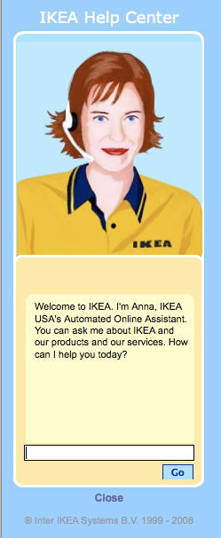
Ask Anna!

Slide 11
PotteryBarn.com
Purpose
Functions
How is the Design?
Aesthetics
Comments

Slide 12
CrateandBarrel.com
Purpose
Functions
How is the Design?
Aesthetics
Comments

Slide 13
CrateandBarrel.com
Web 2.0

Slide 14
Ashley Furniture
Purpose
Functions
How is the Design?
Aesthetics
Comments

Slide 15
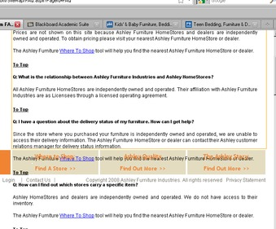
Ashley Furniture
Functionality

Slide 16
Company Message and Audience

Slide 17
Message
IKEA: Deliver affordable home furnishings to its customers.
Pottery Barn: Home furnishings should be exceptional in comfort, style, and quality.
Crate & Barrel: Furniture for every room, every style, every budget.
Ashley Furniture: We want to be the best furniture store.

Slide 18
Audience - IKEA
Cost conscious, modern, forward-thinking and environmentally-aware.

Slide 19
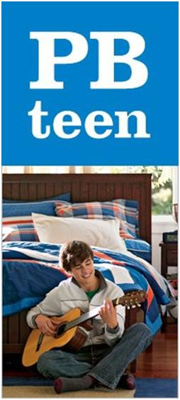
Audience – Pottery Barn
Mature; traditional.
PB Kids
PB Teens

Slide 20
Audience – Crate&Barrel
Mature, established, and contemporary.
CB2
The Land of Nod

Slide 21
Audience – Ashley Furniture
Quality driven, one stop shop research.

Slide 22
Use of Social Media

Slide 23
Analysis Criteria
Blog?
Facebook?
Twitter?
Mobile Site for Smartphone?
Interconnection between media?

Slide 24
IKEA
No official blog
Facebook page IKEA-USA (active, advertisements, IKEA in the news)
Twitter
Individual stores, IKEA-USA had no tweets (sales, weather, local commentary)
Mobile website available
3/5 Stars

Slide 25
Ashley Furniture
No Official Blog
Facebook Page
(inactive, little info, previously active)
Twitter
national and stores (national is inactive, some stores were active)
No mobile website
2/5 Stars

Slide 26
Pottery Barn
No official blog
Facebook page (active, lots of info/links, advertisements, sales, PB in the news)
Twitter
(active, sales and spotlight items, social participation/questions)
No mobile website
3/5 Stars

Slide 27
Crate & Barrel
No Official Blog for crateandbarrel.com
Official Blog for CB2 (social in nature, party hints/recipes, integrates products)
Facebook Page (active, ads, sales, store openings, promotion of new iPhone app)
Twitter
Intermittent usage (last tweet Jan 11th.)
Mobile available
widely advertised.
4/5 stars

Slide 28
Areas for Future Improvement
IKEA
Ashley Furniture
Pottery Barn
Crate&Barrel

Slide 29
Conclusions
Questions
Comments

